Slide 1
APPLIANCES ENERGY PREDICTION
RIJUL GUPTA
87195120

Slide 2
INTRODUCTION
In the era of smart homes, the ability to predict energy consumption not only save money for users but also help in generating money for the user by giving excess energy back to Grid (in case of solar panels usage). In this case regression analysis will be used to predict Appliance Energy usage based on data collected from various sensors.
The energy prediction will come under supervised machine learning task aiming to Appliance energy consumption for a house based on factors like temperature, humidity & pressure. Many techniques, Random Forest Regressor , Linear Regression (in built functions) have been applied to credit predict the energy consumption.
.

Slide 3

OBJECTIVE
Predict the energy of Appliances on the parameters like Temperature, Humidity, Windspeed & Pressure (T1, T1, RH_1, RH_2)

Slide 4
TECHNOLOGY USED
Python
Python is an interpreted high-level general-purpose programming language. Its design philosophy emphasizes code readability with its use of significant indentation. Its language constructs as well as its object-oriented approach aim to help programmers write clear, logical code for small and large-scale projects.

Slide 5
Numpy
NumPy is a Python library used for working with arrays.
NumPy was created in 2005 by Travis Oliphant. It is an open source library and you can use it freely.
NumPy stands for Numerical Python.

Slide 6
Pandas
Pandas is a Python package providing fast, flexible, and expressive data structures designed to make working with “relational” or “labeled” data both easy and intuitive. It aims to be the fundamental high-level building block for doing practical, real-world data analysis in Python. Additionally, it has the broader goal of becoming the most powerful and flexible open source data analysis/manipulation tool available in any language. It is already well on its way toward this goal.

Slide 7
SCIKIT-LEARN
Scikit-learn (Sklearn) is the most useful and robust library for machine learning in Python. It provides a selection of efficient tools for machine learning and statistical modeling including classification, regression, clustering and dimensionality reduction via a consistence interface in Python. This library, which is largely written in Python, is built upon NumPy, SciPy and Matplotlib.

Slide 8
JUPYTER NOTEBOOK
The Jupyter Notebook is an open-source web application that allows you to create and share documents that contain live code, equations, visualizations, and narrative text. It includes data cleaning and transformation, numerical simulation, statistical modeling, data visualization, machine learning, and much more.The Jupyter Notebook is an open-source web application that allows you to create and share documents that contain live code, equations, visualizations and narrative text. It includes data cleaning and transformation, numerical simulation, statistical modeling, data visualization, machine learning, and much more

Slide 9
FLASK
Flask is an API of Python that allows us to build up web-applications. It was developed by Armin Ronacher. Flask’s framework is more explicit than Django’s framework and is also easier to learn because it has less base code to implement a simple web-Application. A Web-Application Framework or Web Framework is the collection of modules and libraries that helps the developer to write applications without writing the low-level codes such as protocols, thread management, etc. Flask is based on WSGI(Web Server Gateway Interface) toolkit and Jinja2 template engine.

Slide 10
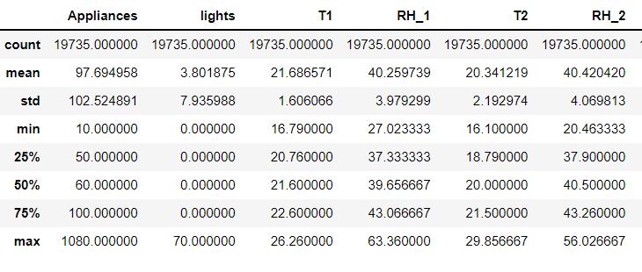
DATASET

Slide 11
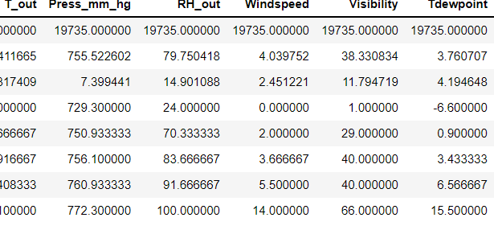

Slide 12
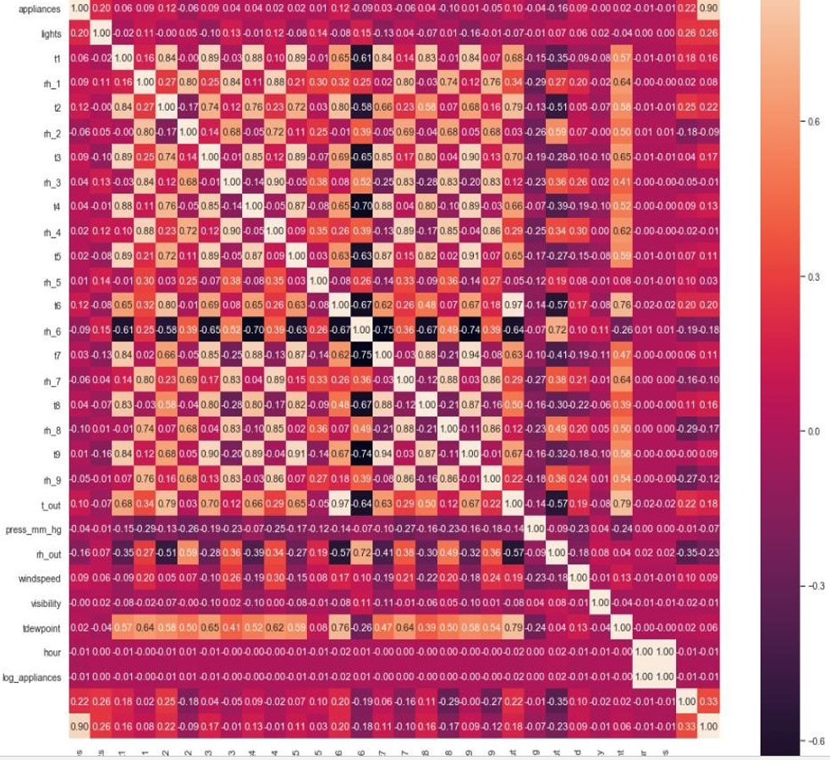
CORRELATION

Slide 13
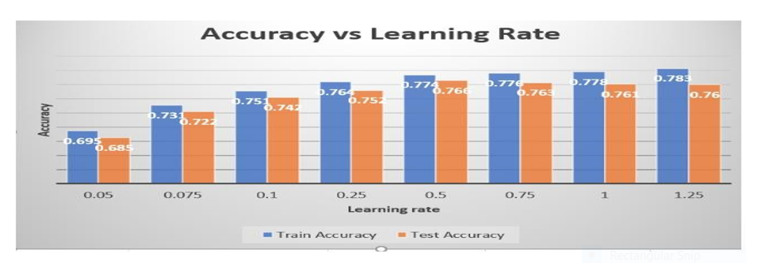
ACCURACY VS LEARNING RATE

